Slide 1
Attendance System
By Robert Kiliszewski | Adrian Sypos | Adrian Golias

Slide 2
Objectives
Remove pen and paper approach.
Stop students from signing in their colleagues.
Store data in a DB.
Connect two parts of application through API.

Slide 3
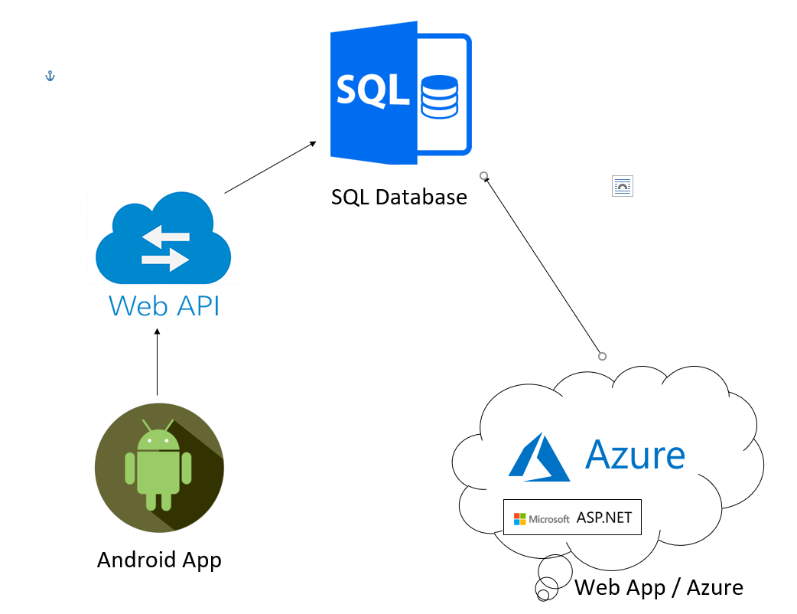
Architecture

Slide 4
Conclusion
Challenging to learn new technologies.
Teamwork didn’t always go as planned.
Time pressure.
Great overall learning experience.

Slide 5
Thank you for listening
We will be happy to answer any Questions.

